Slide 1




BUILT IN EXCELLENCE
VIRTUOSO
PROFILE
https://vpel.in

Slide 2

ABOUT US
Virtuoso Projects & Engineers Pvt. Ltd. Established in 2011 with a strong vision to modernize industries using Technology & has been serving customers in various process domains like Oil & Gas, Water, Sugar, Power, Chemical etc. We have executed more than 400 projects across globe- India, Saudi Arabia, UAE, Malaysia & African countries
We work on continuous improvement through training, using latest technology tools & offering best-fit technical solutions to add value in our offerings to customers.
We partner with leading brands in the industry & also serves highly reputed customers for their complex project requirements.
We are a 500+ engineers team with expertise in various product platforms, Project management & Logistics. They are highly committed & customer focused to meet the customer expectations in terms of delivery timelines & quality.
We headquartered in Pune, India with office premises and state of the art factory setup to assemble the cabinets and staging for FAT spread over 25k sqft. & also operate from UAE having office in Dubai (Sharjha).

Slide 3



PURPOSE
VISION
To create meaningful value for skilled and talented individuals, inspire & empower them to build a long-lasting legacy that positively impacts society
To lead in engineering and technology by modernizing industries for improved efficiency, quality, safety, information accessibility & sustainability

Slide 4



CORE VALUES
Value Customer
Never Give Up
Continual Improvement
  Customer Centric Approach
  Listening to Feedback
  Building a Long-Term Relationship
  Customer Satisfaction
  Adaption to Customer Needs
  Pursues new opportunities
  Have Passion for Winning
  Act with Urgency
  Go beyond our Limit
  Think big and Take bold Actions
  Kaizen Approach
  Data Driven Decision Making
  Employee Involvement
  Skill enhancement
  Process Centered Approach

Slide 5











DOMAIN EXPERTIES
Oil and Gas
Sugar/Distilleries
Tank Farm, LNG Dispensing, Terminal Automation, Pipeline, Utilities​
Mill, Boiler, Boiling House,
Distillery​
Petrochemical
Steel & Cement
Material Conveying, Wagon Tippler, Utility, WHRB​
SRU, Fertilizer, Cracker​
Water
Chemical/Pharma
Desalination, Lift Irrigation, ETP/WTP/STP/RO, City/Cluster Distribution​
Aroma, SRU
Service 03
Power
Equipment
Captive Power, WHRB
Boiler, Compressor, Reactor, Dryer, Heat Exchanger ​

Slide 6

Automation
Gas Solution
Process Engg. & OTS
Electrical
Fire & Security
Software Services
Instrumentation
IOT & Digitization
Life Cycle Services
Tank Farm Mngmt. System
Turnkey Projects
Panel Manufactoring
OFFERINGS

Slide 7
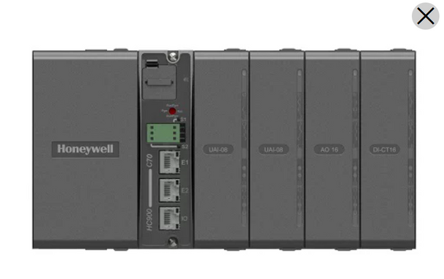
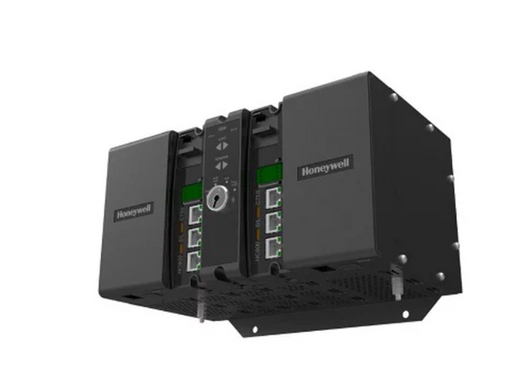
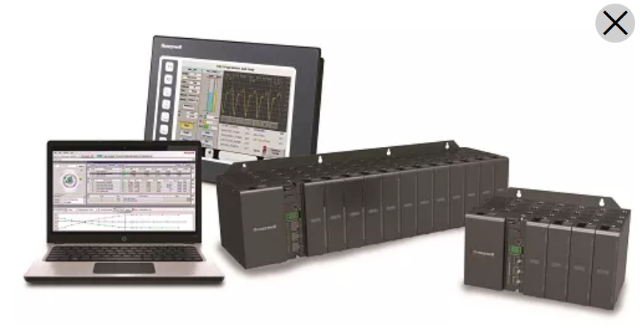
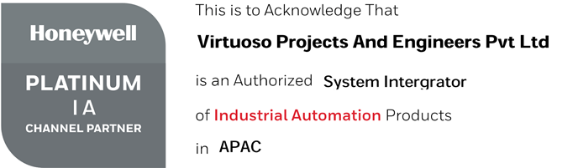
AUTOMATION
Design, Engineering, Supply, Testing & commissioning & following System
DCS
Honeywell Experion PC-C300 and UOC
SCADA
Experion HS
PLC
HC900, ML200, ControlEdge
RTU
SIL2/SIL3 system (Safety System)
HC900 & SMSC
System Integration on Profibus, Profinet, IEC41xx , Modbus, OPC, etc

Slide 8

ELECTRICAL
Turnkey Projects in Electrical Design, Engineering, Supply and commissioning, Switchyard to internal lighting system
  HT/LT Panel
    VCB
    BUS Duct
    Metering Kiosk
    PCC
    APFC
    MCC
    VFD
  Transformer & Switchyard
  Cable Laying
  Cable Tray
  JB, DB
  Lighting
    Industrial Luminaires
    Landscape Luminaires
    Cleanroom Luminaires
    Street Light Luminaires
    Commercial Luminaires
    Battery Backup Luminaires
    High Mast
  Earthing & Grounding

Slide 9

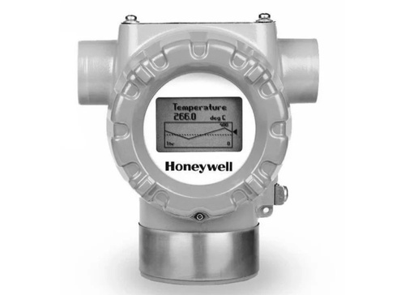
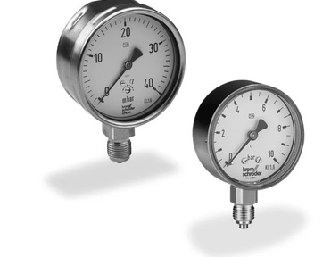
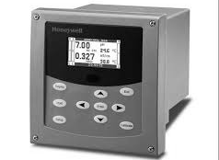
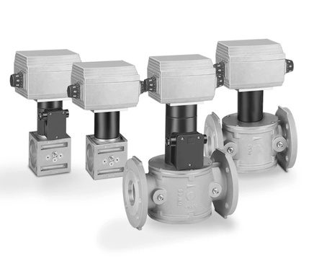
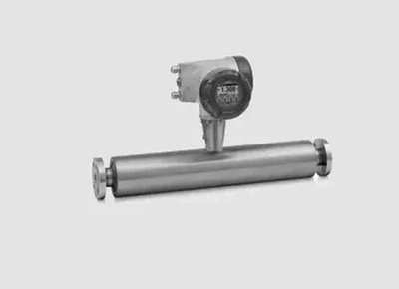








INSTRUMENTATION
Design, Engineering, Supply, Testing & commissioning & following Instruments
Transmitters
  Pressure Guage
  Level Guage
  Rotameter
  pH Analyzer
  Conductivity Analyzer
  Turbidity Analyzer
  O2
  Chlorine
  Globe Control Valve
  On-Off Valve
  Butterfly Valve.
  Pig Signalars
  Intrusive
  Non-Intrusive.
Guages
Analyzer
Control Valve
Special Instruments
  Temp. Transmitter
  Pressure Transmitter
  Differential Pressure Transmitter
  Level Transmitter
      Process Radar
      Ultrasonic
      DP
      GWR
  Flow Transmitter
      Ultrasonic
      Magnetic
      DPT

Slide 10
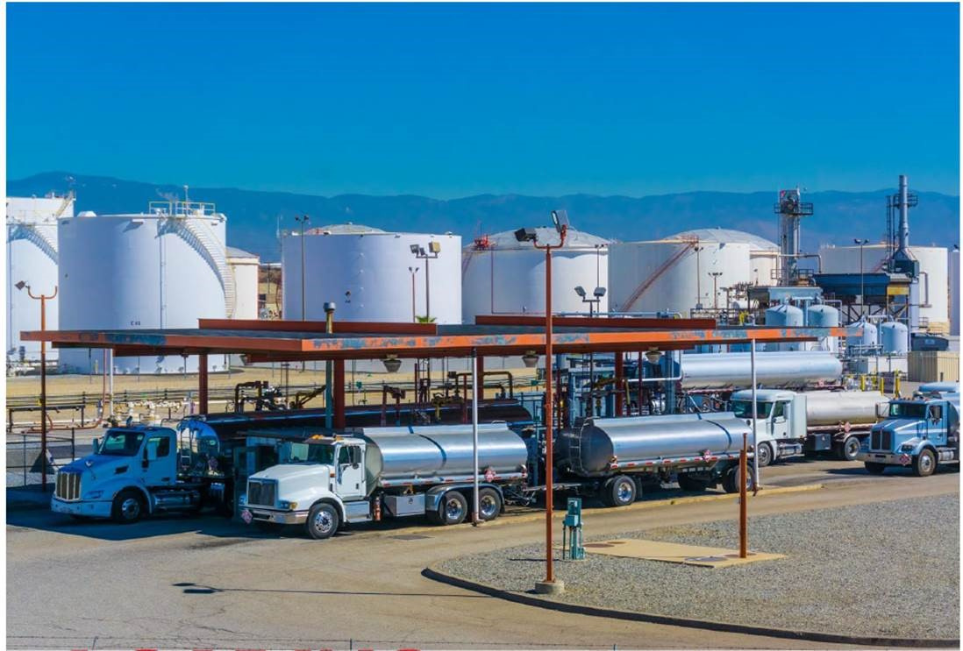
TANK FARM MANAGEMENT SYSTEM & TAS
Design, Engineering, Supply, Testing & commissioning & following system
  Tank Inventory System-Entis
  CIU Unit
  Custody Transfer Radar level Transmitter
  Air Eliminator
  Display & Indicator
  Pressure Transmitter
  Tank side Display
  Batch Controller
  Temp. Measurement
  Multi Spot Temp. Sensor

Slide 11
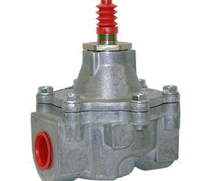
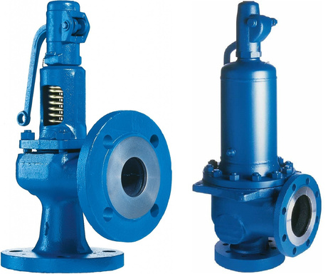
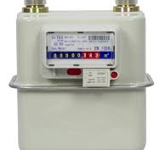
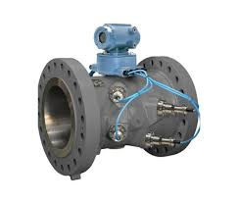
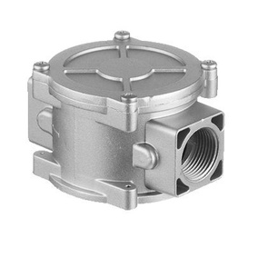
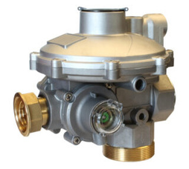
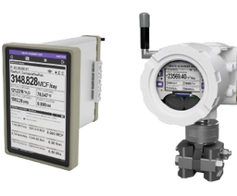
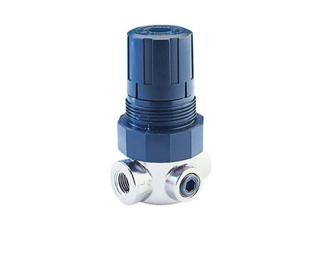
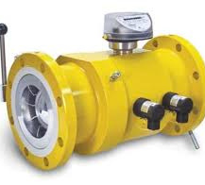
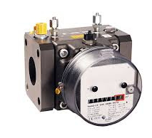
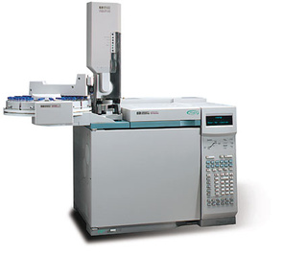
GAS SOLUTION
  Gas Regulator
  Chromatograph
  Flow Computer
  Valves
  Detectors
Safety shut off valves
Safety Relief Valve
Honeywell Elster
Flow Computer
Ultrasonic Meters
Gas Filter
High & Medium Pressure regulator
Chromatograph
Small Pressure Regulator
Turbine Meter
Rotary Meter

Slide 12
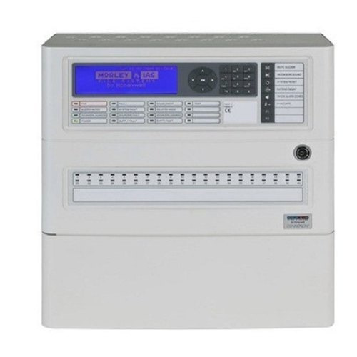

FIRE & SAFETY
  Fire Alarm Panel
  CCTV
  Gas Detection
  Access Control
  Public addressing system

Slide 13
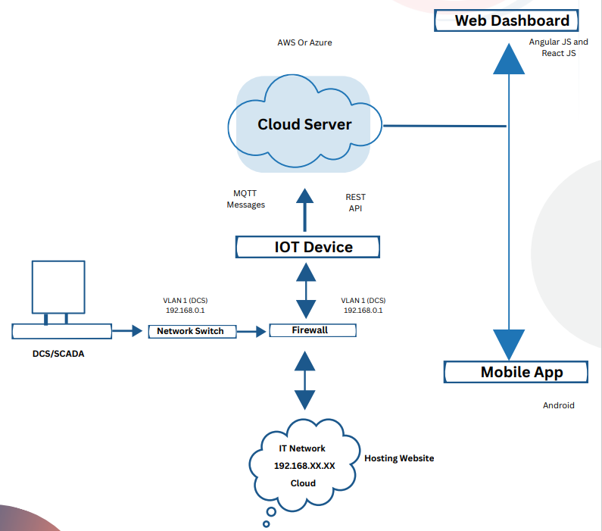
IOT & DIGITIZATION
  IOT Gateway
  Remote Monitoring
  Cyber Security
  ERP Interface
  Reports and Dashboard
  Energy Monotoring System

Slide 14
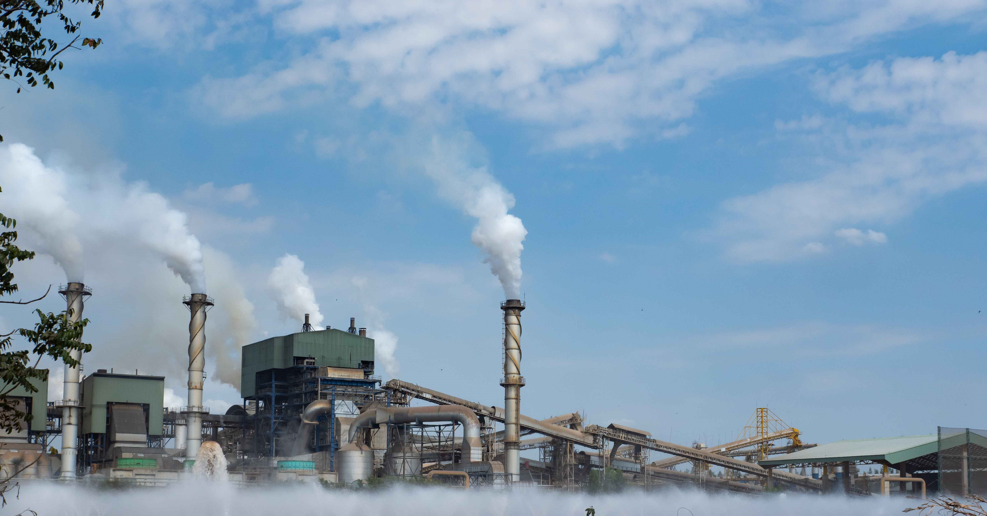
TURNKEY PROJECT
Solution - Engineering - Assembly/Manufacturing - Testing - Commissioning - Handover
Instrumentation
Electrical
Automation
ELV System
  Gauges & Transmitters
  Actuators & Positioners
  Valves
  Indicators & Controllers
  Flow Meters
  Sensors & Switches
  Tanking Gauging
  Cable
  Cable tray
  JB & Glands
  Instrument Hookup
  Earthing
  Gas measurement & Regulation
  HT Panel
  LT Panel
  DG
  UPS
  Power distribution
  Transformer
  Lightings
  Cables Tray & Cable
  Street Lights
  Earthing
  Electrical liasoning
  PLC
  DCS
  SIS
  Monitoring & Control SCADA
  Human Machine Interface (HMI)
  Relay Based Control System
  RTU Integration (Energy Meter,
Smart Relays)
  Web server, Historian
  TFMS
  Fire Alarm
  CCTV
  Access Control
  Public Addressing System

Slide 15
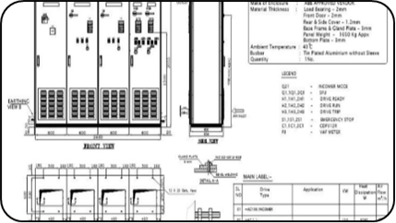
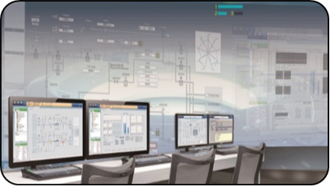


ENGINEERING SERVICES-
AUTOMATION
•EPKS C300 / C200, SM, SMSC
•TPS System – HPM, HG, LM
•Modular Systems – HC900, CE PLC, CE UOC, CE RTU, ML200
•S7 1200 / 1500
•S7 300
•S7 400H
•WinCC
Hardware Design:
Software Engineering
  IO Assignment
  Cabinet GA & Wiring Design – System, Marshalling, PDP (Power Distribution), Server, Network, IRP etc.
  Wiring Database
  Loop Drawings
  Heat Load Calculation
  Signal & System Cable Schedule
  Bill of Material
  Input Reconciliation – Control Narratives, P&ID, C&E, Logic Diagram, IO Database
  Bulk Database Preparation
  Logic Development, Bulk Loops, Complex Loops, Sequence Logic, etc.
  HMI / Graphics Development
  Shapes & Dynamic Linking with Logic
  FAT & SAT Support
•DeltaV Database
•DeltaV Operate
•DeltaV Live
•ControlLogix Series
•Compact Logix Series
•SLC Series
Micro PLC
02.

Slide 16

ENGINEERING SERVICES-
E & I
Instrumentation
Electrical
  Instrument selection as per specification
  IO List
  Instrument index preparation as per P&ID
  Datasheets preparation
  Hook-up Drawing Preparation
  Erection Material Take Off (MTO), etc.
  Cable Schedule
  JB Schedule
  Tray Layout Preparation
  Earthing
  Termination Drawings
  Loop Drawings
  SLD Preparation, Plant Indoor as well as Outdoor Lighting, Floor Plan Layouts, Standard Operation Processes (SOPs) etc.
  Existing System Understanding And Documentation
  AutoCAD & Microstation Drafting
  Panel Designing – MCC, PCC, APFC, VFD etc.
  Testing(FAT) & Commissioning Support
  Skilled engineers for Site Survey, Monitoring / Supervision of Installation and Commissioning, Troubleshooting, etc

Slide 17
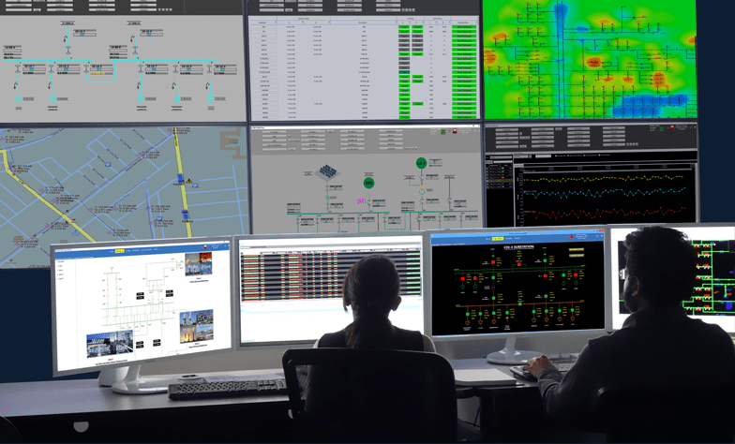




PROCESS ENGINEERING & OTS
  Scenario Training
  Performance Evaluation
  Control System Simulation
  Plant Operation Training
  OTS Document Review(P & ID, PFD, Datasheets)
  Process Model Building
  Model Testing - Startup, Shutdown, Hazop study
  MAT (Model Acceptance Test)
  FAT (Factory Acceptance Test)
  SAT (Site Acceptance Test)
  PDET (Post Data Equalization Test)
Domain
Oil & Gas
Power
Petrochemical

Slide 18

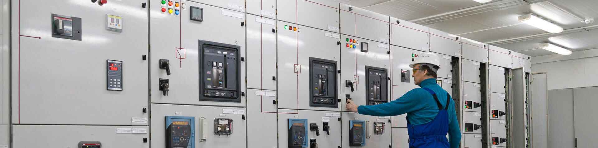
PANEL MANUFACTURING
Electrical Panel
Control Panels
  Motor Control Centers (MCC)
  Power Control Centers (PCC)
  Lighting Distribution Board
  VFD Panels
  APFC panels
  Lighting Distribution Board
  Bus Duct
  IEC61439 complied panels
  Marshalling Cabinet
  System Cabinet
  Network Cabinet
  Server Cabinet
  Relay Control Panel
  Power Distribution Board
  Annunciator Panel

Slide 19
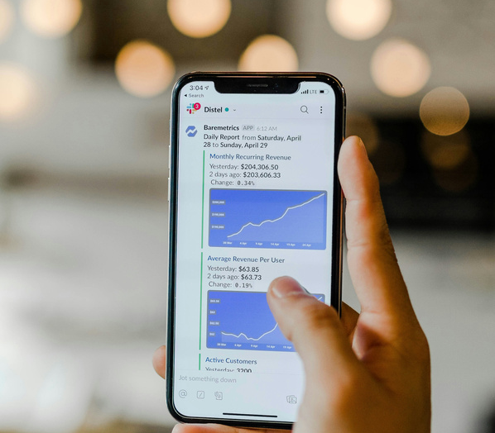
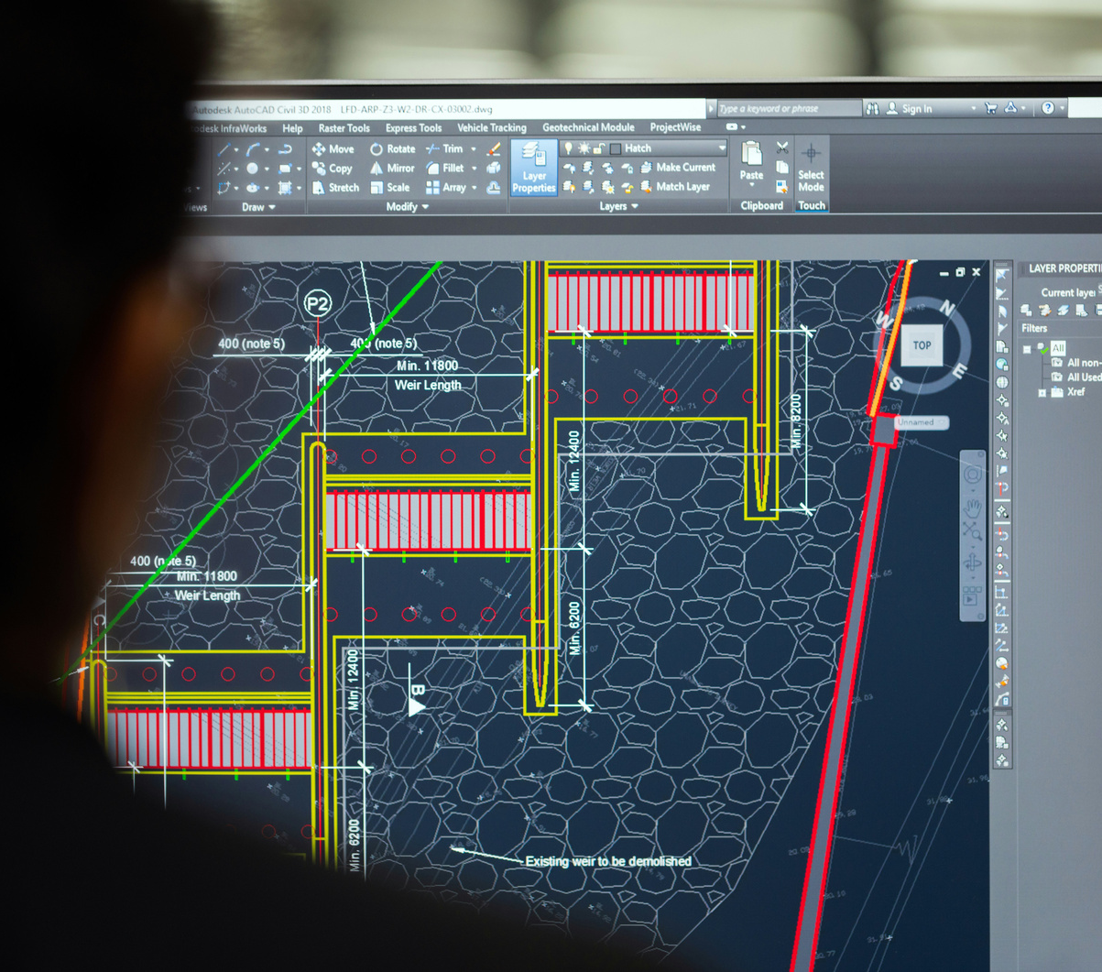

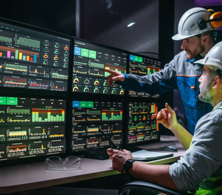







SOFTWARE SERVICES
Mobile Application
Desktop Application
Web Application
E-SCADA
IOT
Customized software development for internal process improvement, Productivity measurement & improvement etc
Products
  CSMS (Charging Station Management System) - Web Application
  Bharat Plug(Mobile Application)
  Real-Time Factory Monitoring Dashboard
  EMS -Energy Monitoring System
  Floor Space Management

Slide 20



LIFE CYCLE SERVICES
Protect your energy assets with Life Cycle services—a wise investment for seamless power continuity!
Instrument Installation, Calibration, Commissoning
System Health check, Network Check, Remote support, Emergency Support, Spare supply
Preventive Maintenance
Emergency spport
Online support
AMC Services
CMC Services
CMC- Comprehensive Maint contract

Slide 21
ICSS-KEY PROJECT
HPCL TAS 11 Locations
KOC GC-31
TCO
Customer :HPCL
Scope : Site Commissioning for Honeywell Safety Manager and ML200 PLC
Customer : Kuwait Oil Company
Scope : Complete System Engineering for Honeywell DCS & Safety Manager
Customer :TCO
Scope : Complete System Engineering for Honeywell DCS & Safety Manager
KOC GC32
Essar Vadinar
KNPC Alzour / KOC LFAR
Customer : Kuwait Oil Company
Scope : Complete System Engineering for Honeywell DCS
Customer : Essar Jamnagar
Scope : Site Commissioning for T&D – Honeywell RTU & SCADA
Customer : KNPC / KOC
Scope :Engineering Support & Site Commissioning Support
IOCL Bongaigaon
NTPC Solapur / Nabinagar
SONATRACH
Customer :NTPC
Scope : Complete System Engineering for Honeywell ML200 for Stacker Reclaimer & Wagon Tripler
Customer : IOCL
Scope : Complete System Engineering for Honeywell DCS, Safety Manager & Site Commissioning
Customer :SONATRACH
Scope : : Complete System Engineering for Honeywell DCS & Safety Manager
TAPCO
Jezan – Saudi Aramco
IOCL Paradip
Customer :TAPCO
Scope : Engineering & Commissioning Support - Shutdown
Customer :Saudi Aramco
Scope : FAT & Site Commissioning for Honeywell DCS & Safety Manager
Customer :IOCL
Scope : Site Commissioning for Honeywell DCS & Safety Manager

Slide 22
TURNKEY PROJECT
Oil & GAS
Water
Chemical
Sugar
Project: Construction Of Crude Oil Storage & Fire Fighting Facilities, Cauvery Asset
Project: Kaleshwaram Pkg20 Lift Irrigation
Project: Otbcha Phase III
Project: 20TPH Boiler & Turbine Electrical & Automation Package.
End Client: ONGC Pundi / KVK / RLM
End Client: Govt. of Telangana, India
End Client: Eternis Fine Chemicals Limited
End Client: Samruddhi Sugars Ltd
Scope :
Design, Engineering, Manufacturing, Supply, Testing & Commissioning of SIL-3 PLC Control System & allied works along with field Instruments. And Integration of Tank Form Management Syetm with PLC.
Scope :
Design, Engineering, Manufacturing, Supply, Testing & Commissioning of Control System & allied works along with field Instruments
Scope :
Design, Engineering , Supply, Installation & Commissioning of complete DCS Control System & Instrumentation.
Scope :
Design, Manufacturing, Supply, Testing & Commissioning of Electrical LT Panels & Honeywell DCS Control Automation Package for Boiler & Turbine.

Slide 23
TURNKEY PROJECT
LNG Dispensing
WHRB
Power
Material Handling
Project: LNG Dispensing Station Wai, Nagpur, India
Project: Upgradation of Essar Vizag Terminal Port (23KM Conveyor Pkg)
Project: 15 MW Power Plant Project
Project: Upgradation of Essar Vizag Terminal Port (23KM Conveyor Pkg)
End Client: IOCL Nashik
End Client: Confidence Power Group, Bangladesh
End Client: Bhagwati Sponge Pvt Ltd Kolkata, India
End Client: Essar Vizag
Scope :
Design, Engineering , Supply, Installation & Commissioning of complete Control System (PLC) and Electrical VFD Panel.
Scope :
Design, Engineering , Supply, Installation & Commissioning of complete DCS System and MCC Panel with Incomer 1600 ampere including 69 Nos. outgoing feeders.
Scope :
Design, Engineering, Manufacturing, Supply and Commissioning of DCS Control System. Waste Recovery Plant : 10 TPH 3 Boilers & 20 TPH 1 Boilers
Scope :
Design, Engineering , Supply, Installation & Commissioning of complete Material Handling system. 12,000 IO's in 11 Number of RIO spread over 30 Km's radius. Refurbishment of 6 Control Rooms, Supply & installation of Porta Cabins.

Slide 24
TURNKEY PROJECTS
OIL & GAS
OIL & GAS
TFMS
LNG Dispensing
Project: Compressor Package & Associated Systems
Project: Construction of Cruid Oil, Storage & Fire Fighting Facility
Project: 3 x 500 MT Capacity of Moulded LPG Storage Vessel at Jammu
Project: LNG Dispensing Station Wai, Nagpur, India
End Client: IOCL Ramnathan
End Client: ONGC Pundi / KVK
End Client: HPCL
End Client:IOCL Nashik
Scope :
Design, Engineering,
Manufacturing, Supply, Testing & Commissioning of SIL-3 PLC Control System & allied works along with field Instruments.
Scope :
Design, Engineering,
Manufacturing, Supply, Testing & Commissioning of SIL-3 PLC Control System & allied works along with field Instruments. And Integration of Tank Form Management System with PLC.
.
Scope :
Design, Engineering , Supply, Installation & Commissioning of complete TFMS System.
Honeywell Enraf Solution.
Scope :
Design, Engineering , Supply, Installation & Commissioning of complete Control System (PLC) and Electrical VFD Panel.

Slide 25
TURNKEY PROJECTS
Water
Water
Water
Power
Project: :Singatalaru Package – 1
Water Treatment & Distribution)
Project:Kaleshwaram Pkg20 Lift Irrigation
Project: 150MLD Desalination Plant
Project: 2x100 MW Nuclear Power Project – DM & PWTS, Chiller System
End Client: Karnataka Neeravari Nigam Ltd.
End Client: AP – GENCO (Local Government Body)
End Client:Chennai Metro
End Client:Nuclear Power Corporation of India Ltd.
Scope :
Design, Engineering, Manufacturing, Supply, Erection and Commissioning of PLC Control System, Instrumentation & Electrical LT Package.
Scope :
Design, Engineering, Manufacturing, Supply, Testing, Erection & Commissioning of Control System & allied works along with field Instruments.
.
Scope :
Design, Engineering , Supply, Installation & Commissioning of complete DCS Control System Package.
Scope :
Design, Engineering, Manufacturing, Supply, Erection and Commissioning of PLC Control System, Instrumentation Package.
.

Slide 26
TURNKEY PROJECTS
Pharma
Pharma
Chemical
Chemical
Project: Expansion Ph1
Project:SRP – 03 Darabssi Punjab – SRU Unit
Project: Otbcha Phase III
Project: : 80KLPD Striper, 80KLPD MEE, 80FD
End Client: Hospera Healthcare Pvt Ltd.
End Client:Nectar Lifesciences
End Client:Eternis Fine Chemicals Limited
End Client:ZCL Chemical Ltd.
Scope :
Design, Engineering , Supply, Installation & Commissioning of complete DCS Control System.
Scope :
Design, Engineering , Supply, Installation & Commissioning of complete DCS Control System & Instrumentation Package for SRU Unit.
.
Scope :
Design, Engineering , Supply, Installation, Erection & Commissioning of complete DCS Control System & Instrumentation Package.
Scope :
Design, Engineering , Supply, Installation, Erection & Commissioning of complete Electrical & Instrumentation Package.

Slide 27
TURNKEY PROJECTS
Sugar
WHRB
Power
Material Handling
Project: : Turnkey Sugar Plant & Distillery
Project:Secondary Power Generation System
Project: Tuticorin 525 MW Thermal Power Plant BOP Package
Project:Upgradation of Essar Vizag Terminal Port (23KM Conveyor Pkg)
End Client: Sopanraon Balakrishna Dhasal SSK
End Client:Confidence Power Group, Bangladesh
End Client:SEPC Power Pvt Ltd. Tuticorin
End Client:Essar Vizag.
Scope :
Design, Manufacturing, Supply, Testing & Commissioning of Honeywell,DCS,Control,Automation Package, Instrumentation * Electrical LT Panels for 55TPH Boiler, Mill, PAN, Turbine & 60KLPD Distillery.
Scope :
Design, Engineering , Supply, Installation & Commissioning of complete DCS System and MCC Panel with Incomer 1600 ampere including 69 Nos. outgoing feeders.
.
Scope :
Design, Engineering, Manufacturing, Supply, Erection and Commissioning of DCS Control System & Instrumentation Package.
Scope :
Design, Engineering , Supply, Installation & Commissioning of complete Material Handling system. 12,000 IO's in 11 Number of RIO spread over 30 Km's radius. Refurbishment of 6 Control Rooms, Supply & installation of Porta Cabins.

Slide 28

























CUSTOMER

Slide 29







CONTACT US
We value every inquiry, question, and collaboration opportunity. Drop us a message, and let’s start a conversation that could redefine the way you approach engineering solutions.
+91-772201-14121
http://vpel.in
sameer.G@vpel.in
108, 109, Pride Icon, Mundhwa - Kharadi Rd, next to Columbia Asia Hospital, Thite Vasti, Thite Nagar, Hadapsar, Pune, Maharashtra 411014
FACTORY
Gat No.112, Pimpalgaon, Post Solu, MIDC Markal, Tal Khed, Dist Pune, Pin Code-412105
+91-76669-45486
http://vpel.ae
shoib.sheikh@vpel.in
Virtuoso Middle East FZE P1-ELOB Office No E-27 F-23 Hamriyah free zoe sharjah, UAE

Slide 30

BUILT IN EXCELLENCE
THANK YOU

